Slide 1
Lachlan Robbie
T1_A2 Assignment - Website Portfolio
The Coder Academy

Slide 2
Function and Design
Four Key Points:
Responsiveness
Ease of Use
Accessibility
Purposeful

Slide 3

Responsiveness
No matter the device, the website will create a tailored experience to help better suit the user and their user experience.
Changes to navigation based on device
Amount of content displayed on the screen at one time
CSS function based off device usage e.g. on hover selections in pseudo elements

Slide 4


Ease of Use
I want this site to be able to be accessed by everyone, no matter their level of experience. And while the primary target audience is peers and employers in the industry, simplicity is vital for those who would like to explore the pages too.
Simple navigation systems; top navigation bar for tablets and computers, hamburger menu for mobile phones.
A site map that has clearly defined paths, providing an easy to navigate

Slide 5

Accessibility
Ensuring the website is accessible to all no matter their abilities was important. Having things in place such as alternate text for images to allow for the use of screen readers for people who are blind is just one of these features. This is another area where the overall responsiveness and ease of use come into play.

Slide 6
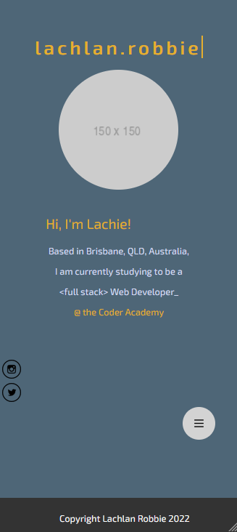
Purposeful
Direct and to the point
No overloaded content
Each segment clearly defined and clear

Slide 7
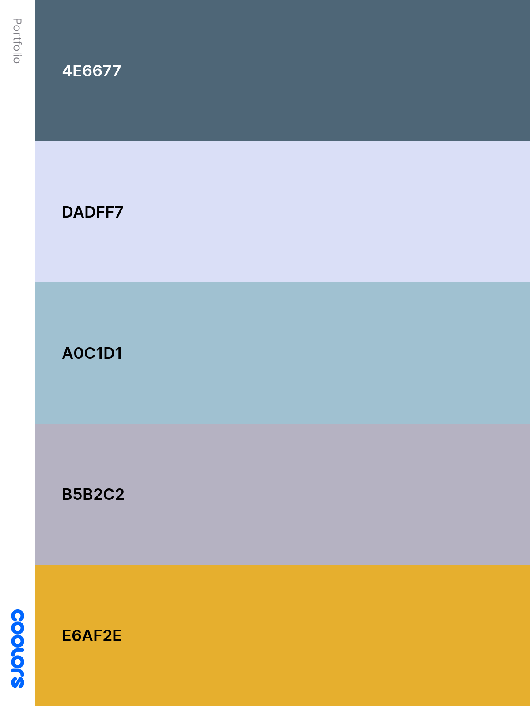
Colour Pallette
Complementary colours that provide base for the website, accenting off each other for a site where muted and bright colours work together for a modern aesthetic.

Slide 8
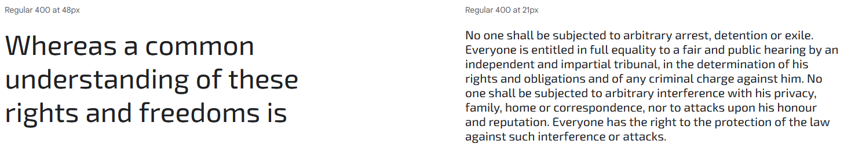
Typography - Exo 2

Slide 9
Components
Navigation:
Hamburger menu for mobile users, easy to locate on smaller screens
Top navigation bar for tablet and computer users, larger screens allow for more content on the screen, having this bar along top ensures all content is presented uninterrupted.
Content:
Semantic HTML elements to clearly define each segment of the website
Post preview blocks allow for a preview of the content before entering that page
About page contains a link for my person resume
Each post, contains an image in both the preview and on the full page content when selected.

Slide 10
Components - Continued
Social Networking:
Each page has fixed to screen social networking shortcuts using <a> tags, providing quick access to further connect with me on other platforms such as Github and LinkedIn
Footer:
The footer provides the website copyright and provides the bottom piece to the container of the website.
Animation:
The home page contains some simple keyframe animation to provide some uniqueness to the user experience.

Slide 11
The Process
Wireframing
HTML outlining a base page in the index page
Applying basic CSS to the HTML structure
Translating the basic html structure into the rest of the pages of the site.
Applying JavaScript to the hamburger menu to get the mobile navigation menu functioning
Applying some more in-depth CSS techniques
Touching up html and css code to make sure it is presented in a matter that if someone else were to pick it up, they could understand what is happening.

Slide 12
Challenges
Time management
Keeping structure
Indecisiveness
Planning

Slide 13
SiteMap
Home
About Me
Blog Posts
Projects
Blog 1
Project 1
Blog 2
Project 2
Blog 3
Project 3
Blog 4
Blog 5

Slide 14
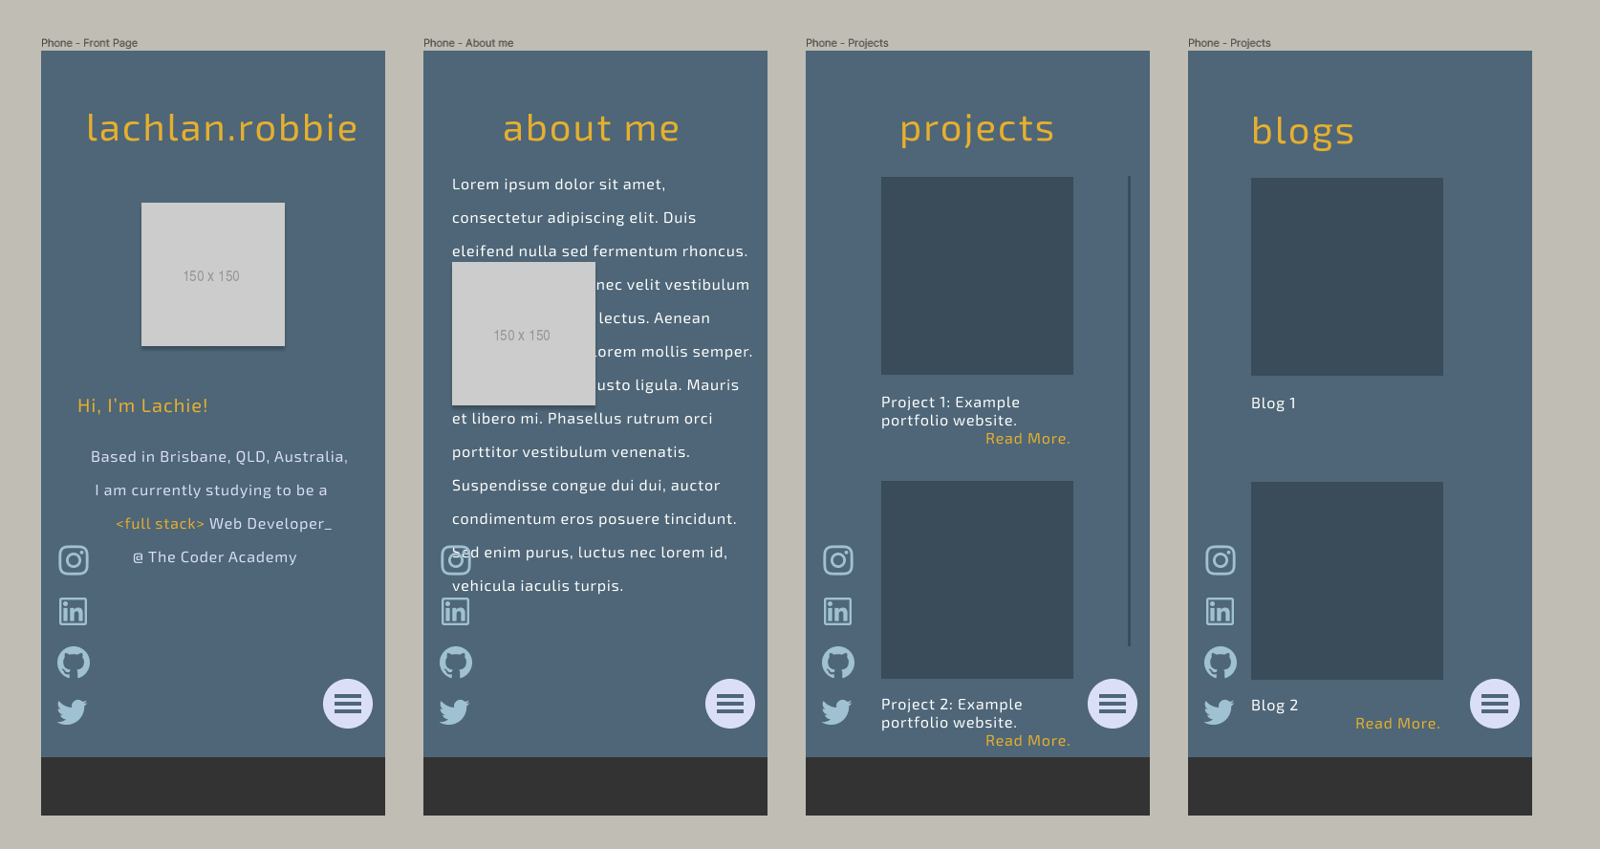
Design - WireFraming (Mobile)

Slide 15
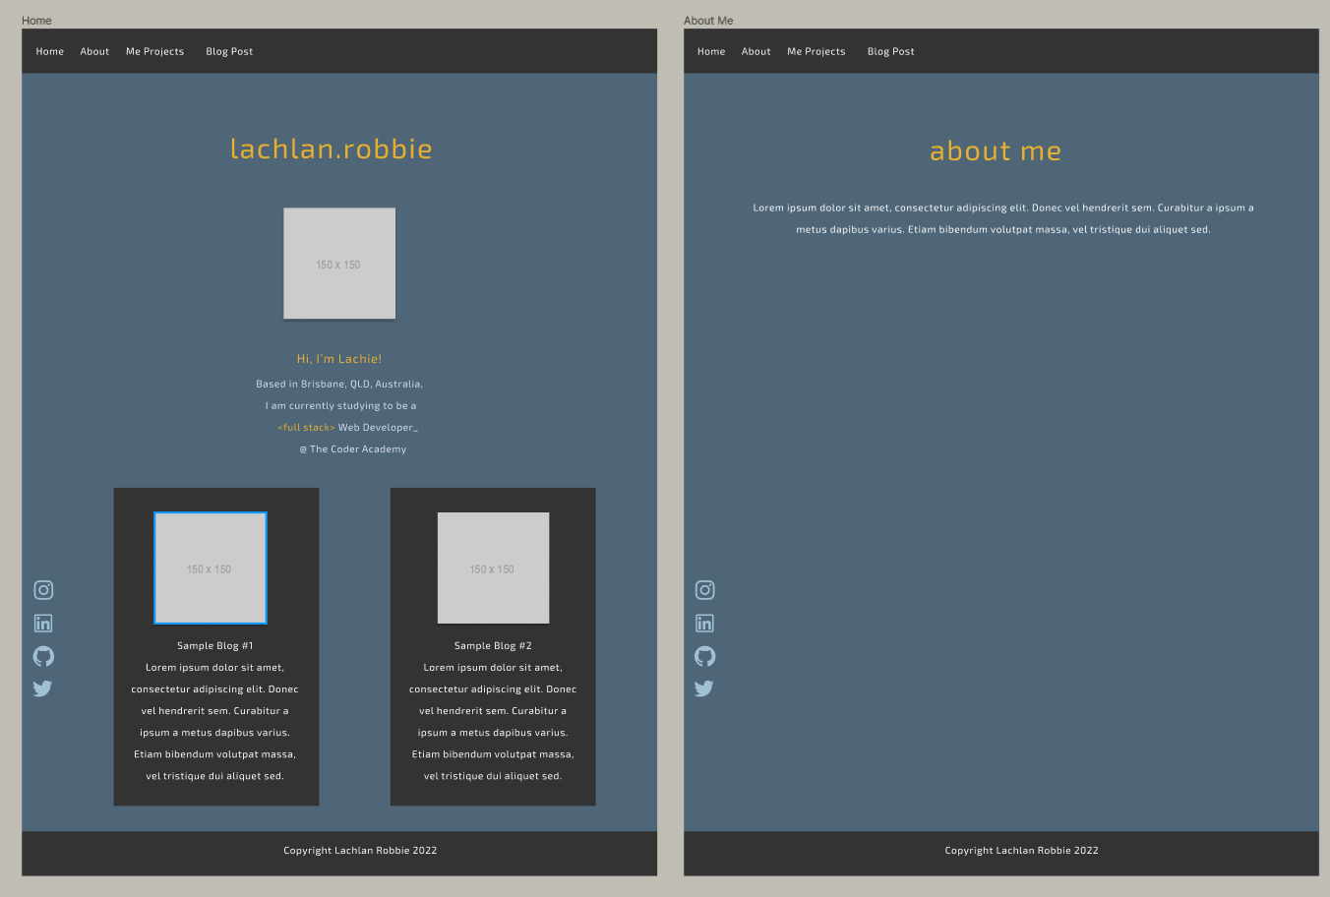
Design - WireFraming (Tablet)

Slide 16
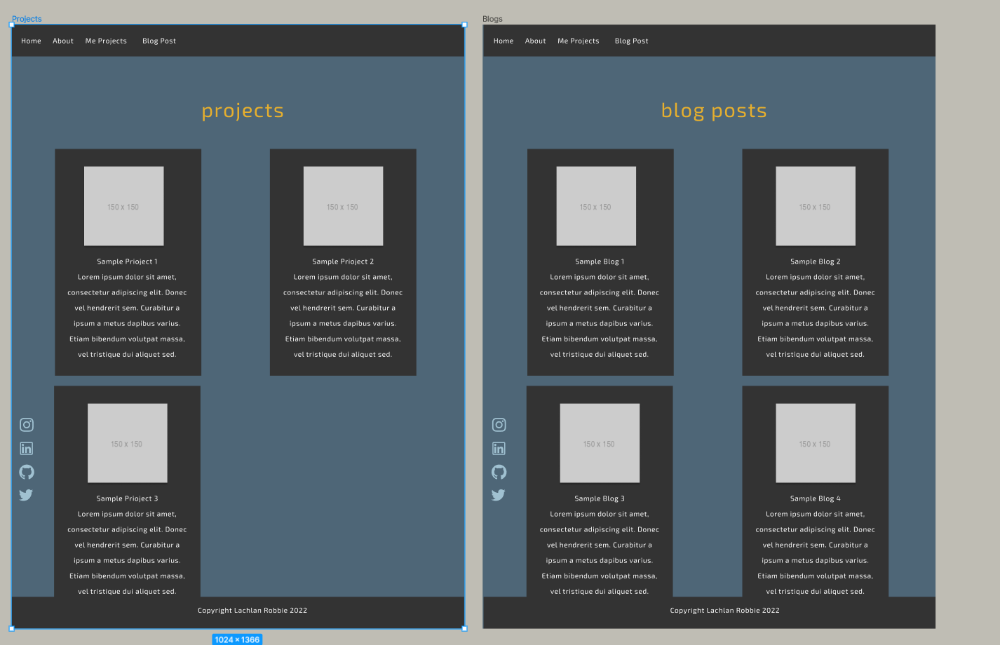
Design - WireFraming (Tablet)

Slide 17
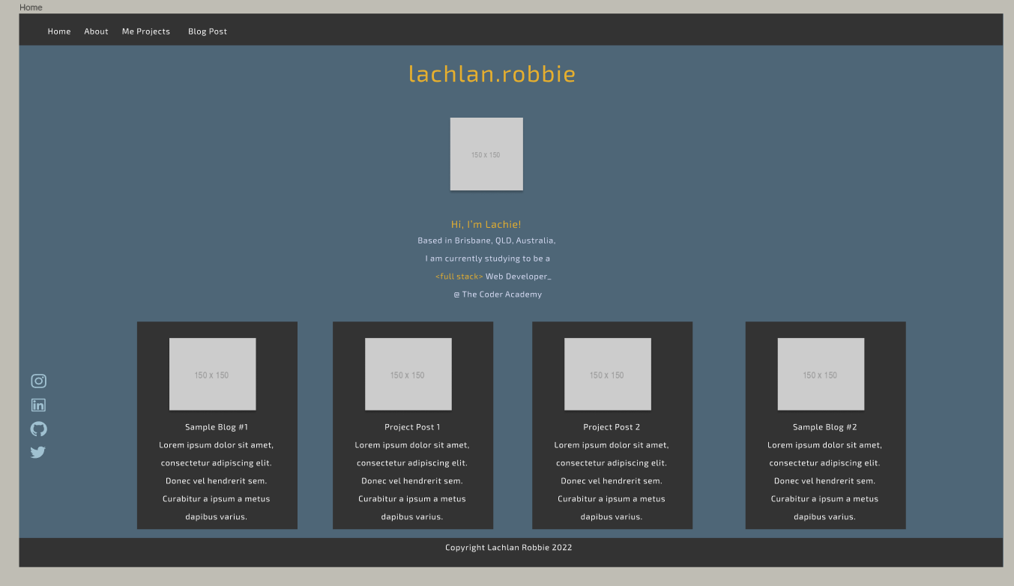
Design - WireFraming (Computer)

Slide 18
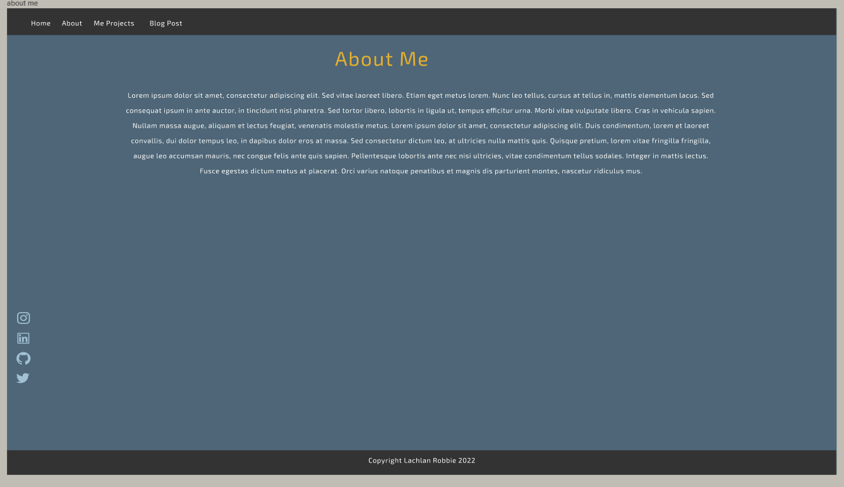
Design - WireFraming (Computer)

Slide 19
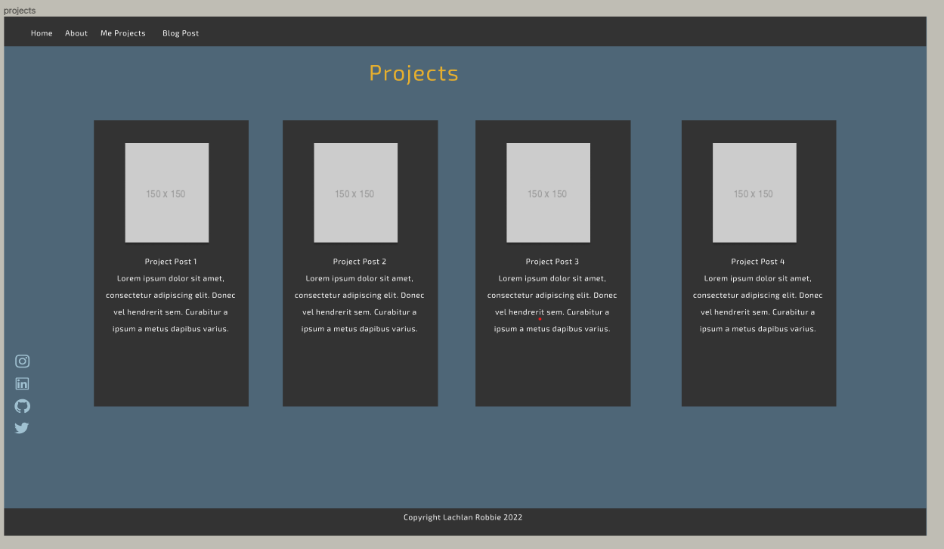
Design - WireFraming (Computer)

Slide 20
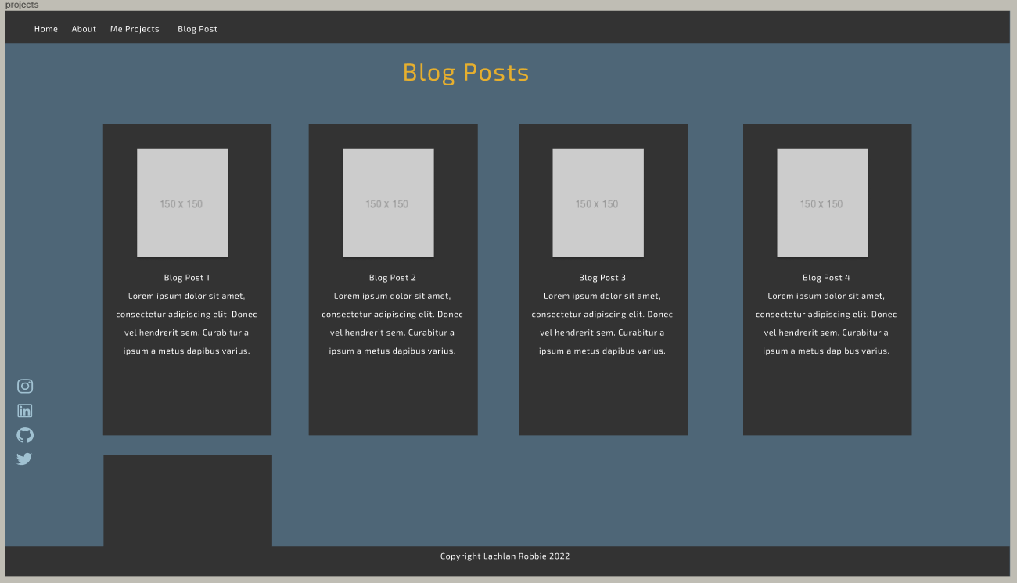
Design - WireFraming (Computer)

Slide 21
Thank you!
This is my first proper project I have worked on and while there are many changes and improvements I would like to make, I am happy with the final result as it serves as a proper stepping stone into my developing career.

